Slide 1
Path Navigation using Deep Q Learning
Guide :Dr.S.Muthurajkumar
Rahul B (2019503545)
L S Sanjay kumar (2019503042)
Gokkul E(2019503517)

Slide 2
Abstract :
There is an increased need for automation in this ever advancing technological world.
Automation reduces time, money, labour, while also reducing manual errors, giving you more time to concentrate on other work.
Manual tasks are hectic and boring, sometimes they are dangerous considering the work.
Navigation plays a vital role in many industries, some of them are vehicles, drones, transportation, and there are certain cases where navigation might be dangerous like deep forest, underground, underwater, firefighting environments.
Visually challenged people have a difficult time navigating unfamiliar places. So there is a necessity for an automatic navigation system to overcome these situations.
Hence in our project we will be implementing automatic path navigation simulation using deep Q-learning (a Machine Learning technique).
This path navigation system when assigned its destination automatically finds the shortest route and avoid the obstacle in order to reach its destination

Slide 3
Introduction :
A path navigation system using Deep Q learning is presented in this project. Initially an environment is created with the help of Kivy software Then an object is created with 3 sensors .
The object will have to avoid obstacles that are created dynamically by the user and reach its destination by taking the shortest path .
Here we will be using Deep Q Learning algorithm ( Reinforcement Learning) wherein the object will be trained based on reward and penalty mechanism.
The main aim of this project is to make an object automatically navigate to its destination by avoiding the obstacles .

Slide 4
Objective :
To build an environment with an object and 3 sensors(one right sensor ,one left sensor and one straight sensor.
To build an obstacle creator and assign a function to the object (i.e.)The object has to turn left or right in order to avoid the obstacle
To implement deep Q learning algorithm to train the object in order to avoid the obstacle and find the shortest path to reach its destination

Slide 5
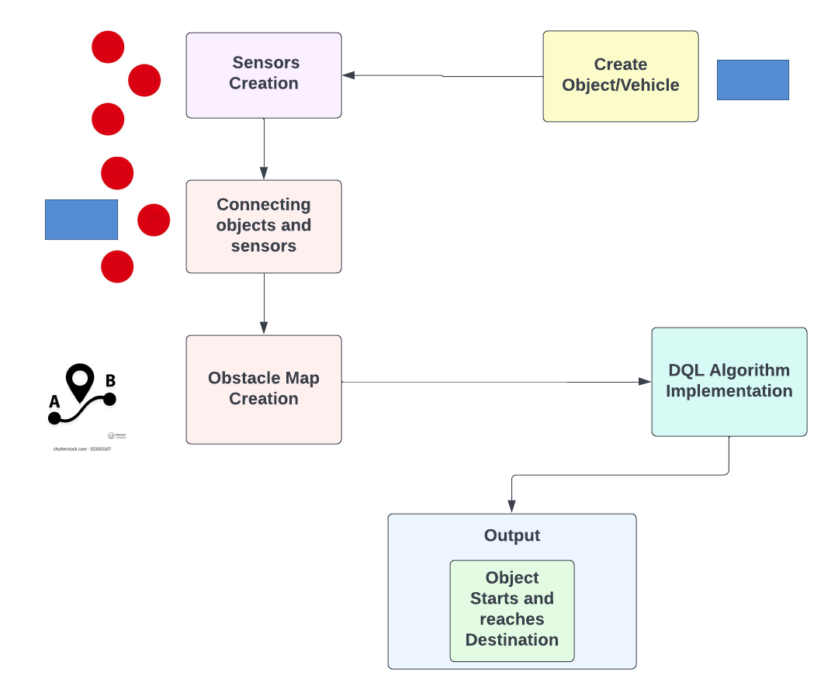
Architecture Diagram
Figure 1

Slide 6
Architecture Diagram
The project’s Architecture diagram has 6 Components ,
Create Object/Vehicle
This module creates the object required, that is the vehicle using Kivy with any desired shape and size .
2) Sensors Creation :
This module creates the 3 sensors ,the left sensor,the right sensor and the straight .The main purpose of these sensors are to detect the obstacles ,if there are any.
3) Connecting objects and sensors :
This module connects the 4 objects into a single entity, that is it connects the object with 3 sensors .

Slide 7
Architecture Diagram :
4) Obstacle Map Creation :
In this module, we create an environment/map for the object to navigate from source to destination .We have also added clear(deletes the obstacle) , save (saves the obstacle design) and load (loads the previously saved obstacle design ) options .
5) DQL Algorithm Implementation :
This module deals with the DQL Algorithm which is used by the object to learn to avoid obstacles.If the object detects any obstacle from any of the three sensors it turns to the opposite direction by 20 degrees and moves towards its destination. Here reinforcement learning method is used along with deep Q learning where they will be awarded with a reward for every step the move closer to the destination and a penalty will be given when it moves away from the destination and aim of it is to maximise its reward points.
6) Object starts and reaches destination :
This module deals with the object moving from its initial point by dodging all the obstacle and by finding the shortest route to reach to the designated destination.

Slide 8
Proposed work
The goal of this simulation is to build an environment with a complex path, an object with 3 sensors which uses Deep Q-Learning to train the object and to assign a destination for the object to reach.
Anaconda is what we’ll use to install PyTorch and Kivy. It is a free and open source distribution of Python which offers an easy way to install packages.

Slide 9
Proposed Work :
We will build this 2D map inside a Kivy webapp. Kivy is a free and open source Python framework with a user interface inside which you can build your games or apps. It will be the
container of the whole environment.
PyTorch is the AI framework used to build our Deep Q-Network. PyTorch is great to work with and powerful. It has dynamic graphs which allow fast computations of the gradient of complex functions, needed to train the model.
This can be divided into 3 integral parts to simplify the process ,
1.To create an environment with the object and sensors.
2.To build the obstacle creator and to assign functions for the objects.
3.Implementing Deep Q-Learning to train the object.

Slide 10
Modules :
Module 1 : To create an environment with the object and sensors.
We create the environment and we use Kivy WebApp to create 4 Kivy objects, a rectangle shape representing the object and three sensors to detect any obstacle and to navigate to the destination.
We set our object to go from the upper left corner of the map, to the bottom right corner.
Create 3 buttons: Clear, Load and Save.

Slide 11
Module 2 : To build the obstacle creator and to assign functions for the objects.
We build a system to draw different obstacles in the environment.
We assign functions to the objects to make it go through any path we create from the start to the end point.
Assign function to Clear button.

Slide 12
Module 3 : Implementing Deep Q-Learning to train the object.
Using Deep Q-Learning we build and train our object to navigate its way avoiding any obstacles to its destination.
Assign functions for Load and Save buttons.

Slide 13
Algorithm
Step 1 : Importing the libraries and the Kivy packages.
Step 2 : Initialising variables to keep the last point in memory when we draw the sand on the map , the total number of points in the last drawing , the length of the last drawing.
Step 3 : Create the brain of our AI, list of actions and the reward variable :
4 inputs, 3 actions, gamma = 0.9.
action = 0 => no rotation, action = 1 => rotate 20 degrees, action = 2 => rotate -20 degrees.
The reward received after reaching a new state.

Slide 14
Algorithm
Step 4 : Initialising the map :
Sand is an array that has as many cells as our graphic interface has pixels. Each cell has a one if there is sand, 0 otherwise.
Building x-coordinate and y-coordinate of the goal.
Initializing the sand array with only zeros.
The goal to reach is at the upper left of the map. (the x-coordinate and y-coordinate)
Initializing the last distance from the object to the goal.
Step 5 : Creating the object class :
Initializing the angle of the object.
Initializing the last rotation of the object.
Initializing the x-coordinate and y-coordinate of the velocity vector and the velocity vector.
Initializing the x-coordinate and y-coordinate of all 3 sensors and their respective sensor vectors.

Slide 15
Algorithm
Step 6 : Updating the position of the object according to its last position and velocity :
Getting the rotation of the object.
Updating the angle and the position of sensors 1,2 and 3.
Updating the signal received by sensors 1,2 and 3. (density of sand around sensor 1,2,3)
If any sensor is out of the map (the object is facing one edge of the map) that sensor detects full sand.
Update sensors 1,2 and 3.
Step 7 : Creating the game class :
Getting the object and the sensors 1,2 and 3 from our kivy file.
Starting the object when we launch the application.
The object will start at the center of the map.
The object will start to go horizontally to the right with a speed of 6.

Slide 16
Algorithm
Step 8 : Update function that updates everything that needs to be updated at each discrete time when reaching a new state (getting new signals from the sensors) :
Specifying the global variables.
Store width and height of the map (horizontal edge and vertical edge).
Storing the difference of x-coordinates and of y-coordinates between the goal and the object.
Initializing the direction of the object with respect to the goal (if the object is heading perfectly towards the goal, then orientation = 0)
Initializing our input state vector, composed of the orientation plus the three signals received by the three sensors.
Updating the weights of the neural network in our ai and playing a new action
Converting the action played (0, 1 or 2) into the rotation angle (0°, 20° or -20°)
Moving the object according to this last rotation angle
Getting the new distance between the object and the goal right after the object moved
Updating the positions of the 3 sensors 1,2 and 3 right after the object moved.

Slide 17
Algorithm
Step 9 : Assigning reward system :
If the object is on the sand, it is slowed down (speed = 1) and reward = -1.
Otherwise it gets a bad reward of -0.2.
However if it is getting closer to the goal it still gets a slightly positive reward of 0.1.
If the object is on any edge of the frame (top,right,bottom,left), it comes back 10 pixels away from the edge and it gets a bad reward of -1.
When the object reaches its goal, the goal becomes the bottom right corner of the map and vice versa (updating of the x and y coordinate of the goal).
Updating the last distance from the object to the goal.
Step 10 : Painting for graphic interface :
Putting some sand when we do a left click.
Put some sand when we move the mouse while pressing left.
Step 11 : API and switches interface :
Building the app.
Creating the clear, save and load buttons.
Running the app.
Step 12 : Build and run the application.

Slide 18
Tools Used
Kivy - To create the environment and the objects.
Kivy is an open source multi-platform GUI development library for Python and can run on iOS, Android, Windows, OS X, and GNU/Linux. It helps develop applications that make use of innovative, multi-touch UI. The fundamental idea behind Kivy is to enable the developer to build an app once and use it across all devices, making the code reusable and deployable, allowing for quick and easy interaction design and rapid prototyping.

Slide 19
Tools Used
PyTorch Framework - To implement the Deep Q Learning algorithm and to build the Path Navigating System.
PyTorch is an open source machine learning (ML) framework based on the Python programming language and the Torch library. It is one of the preferred platforms for deep learning research. The framework is built to speed up the process between research prototyping and deployment.
PyTorch is similar to NumPy and computes using tensors that are accelerated by graphics processing units (GPU). Tensors are arrays, a type of multidimensional data structure, that can be operated on and manipulated with APIs. The PyTorch framework supports over 200 different mathematical operations.
The popularity of PyTorch continues to rise as it simplifies the creation of artificial neural network (ANN) models. PyTorch is mainly used for applications of research, data science and artificial intelligence (AI).

Slide 20
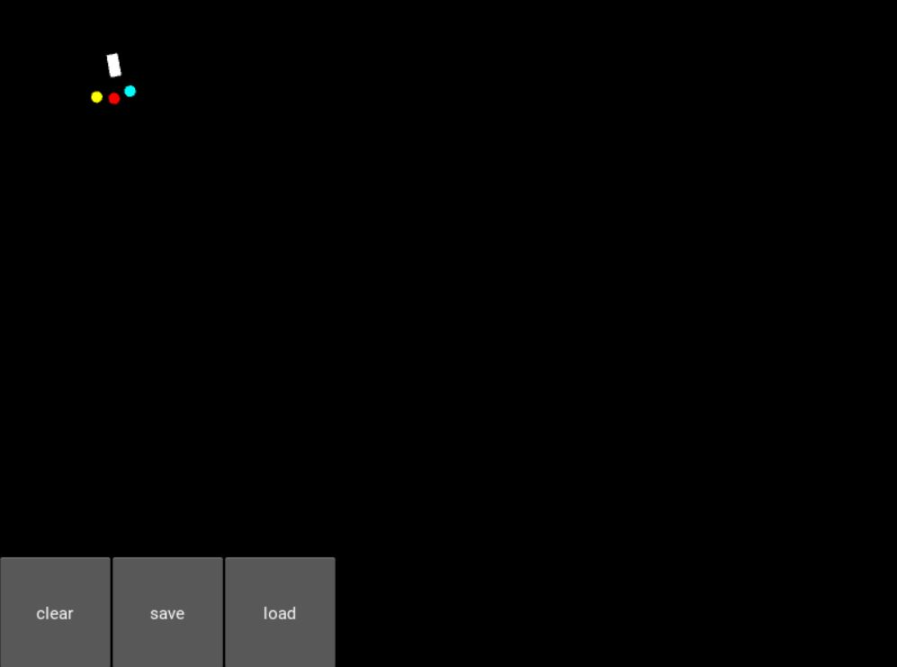
Implementation
Module 1 : To create an environment with the object and sensors.
The environment with objects are created, the object is set to go from the upper left corner of the map to the bottom right corner.
The object starting at the top left of the map(starting point) is shown in Figure 2.
Figure 2

Slide 21
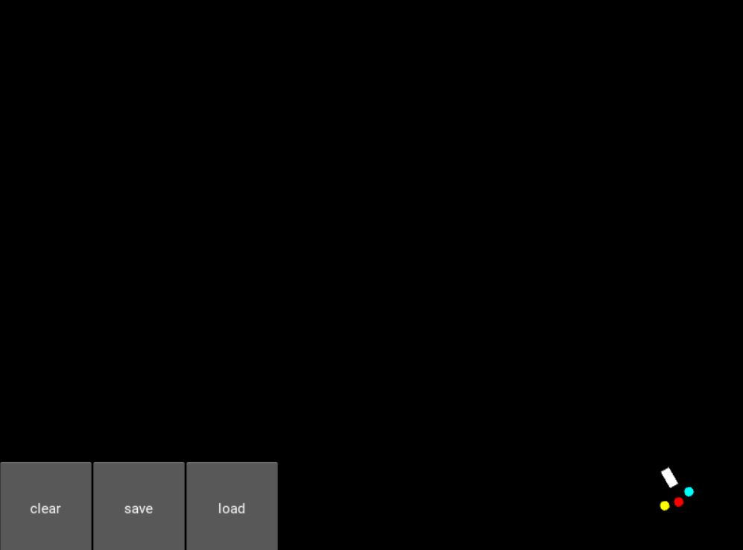
Implementation
Three buttons are created : Clear, Load and Save.
The object reaching the bottom right of the map(destination) is shown in Figure 3.
Figure 3

Slide 22
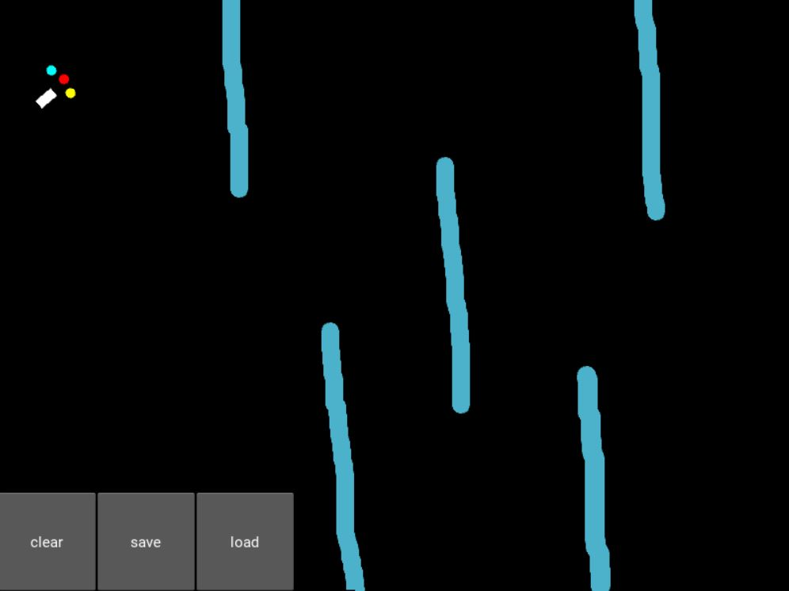
Implementation
Module 2 : To build the obstacle creator and to assign functions for the objects.
Obstacle creator using mouse pointer is built, It allows us to draw different obstacles in the environment on which the object is tested.
Obstacle is created using the obstacle creator we implemented, it can be hand drawn by us to build various different obstacles as shown in Figure 4.
Figure 4

Slide 23
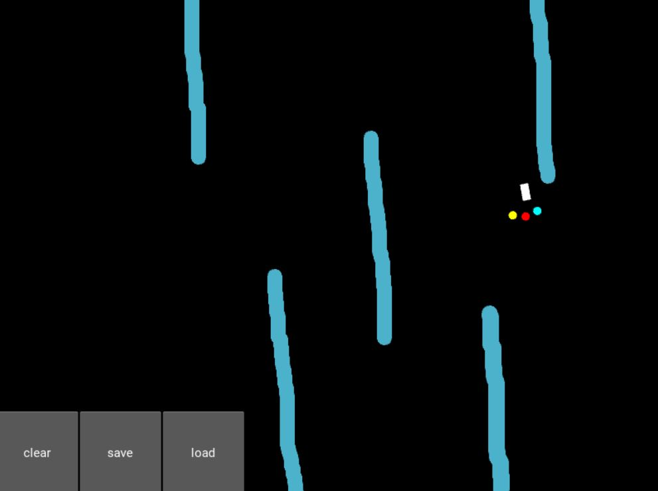
Implementation
Functions are assigned to the objects to make it go through any path we create from the start to the end point. The clear can refresh the obstacle.
The movement of the object through the obstacle is shown in Figure 5.
Figure 5

Slide 24
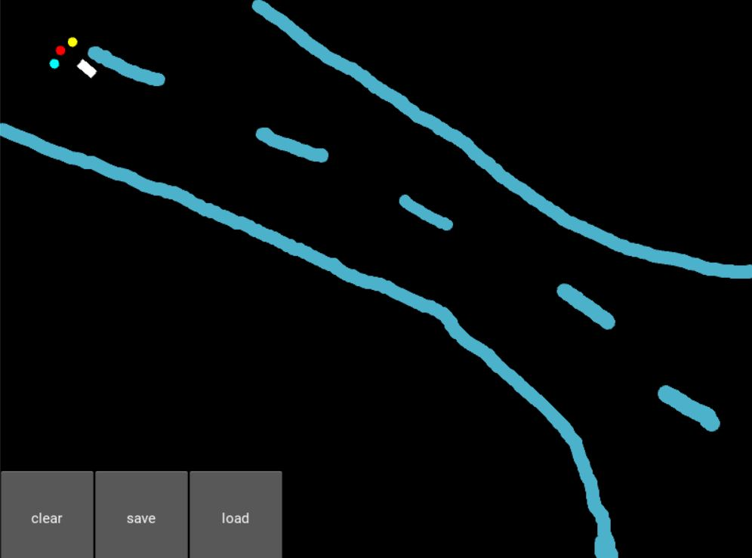
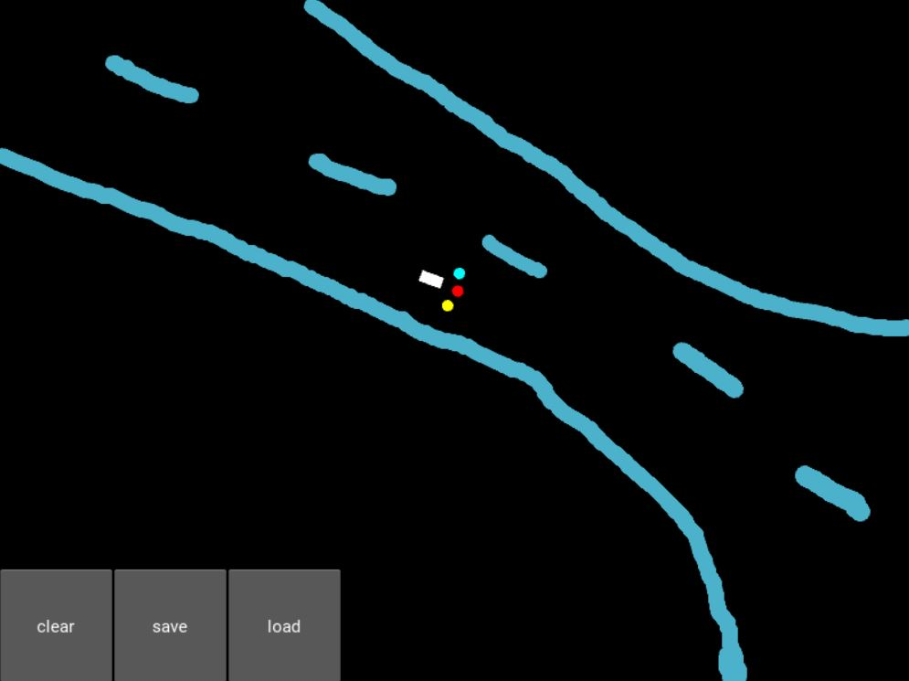
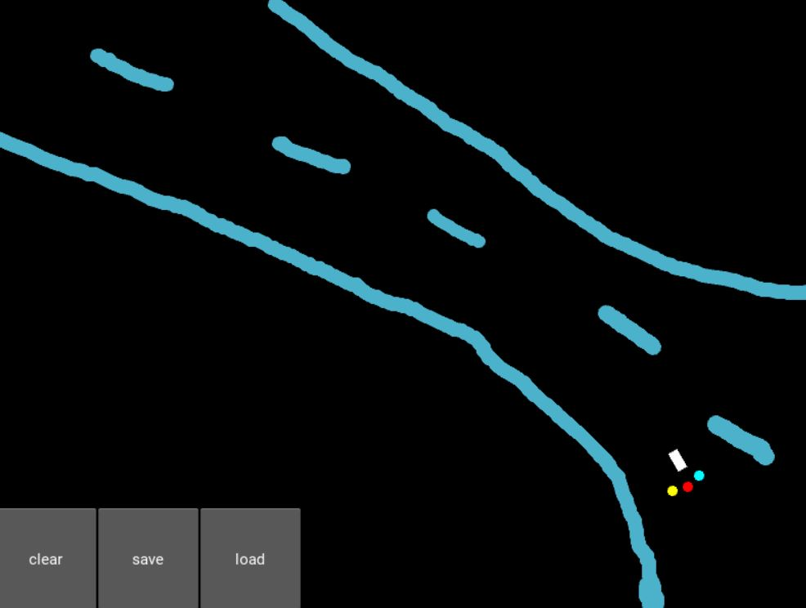
Implementation
Module 3 : Implementing Deep Q-Learning to train the object.
Figure 6
Figure 7
Figure 8

Slide 25
Implementation
Module 3 : Implementing Deep Q-Learning to train the object.
We built and trained our object to navigate its way avoiding any obstacles to its destination using Deep Q-Learning.
Assign functions for Load and Save buttons.
Figure 7 shows the object travelling through the obstacle , to reach the destination.
Deep Q-Learning is used to train the object to learn the best route for the object to reach the destination, it checks all possible routes and then follows the best route , this is shown in figures 6, 7 and 8.
Functions are assigned for the load and save buttons.

Slide 26
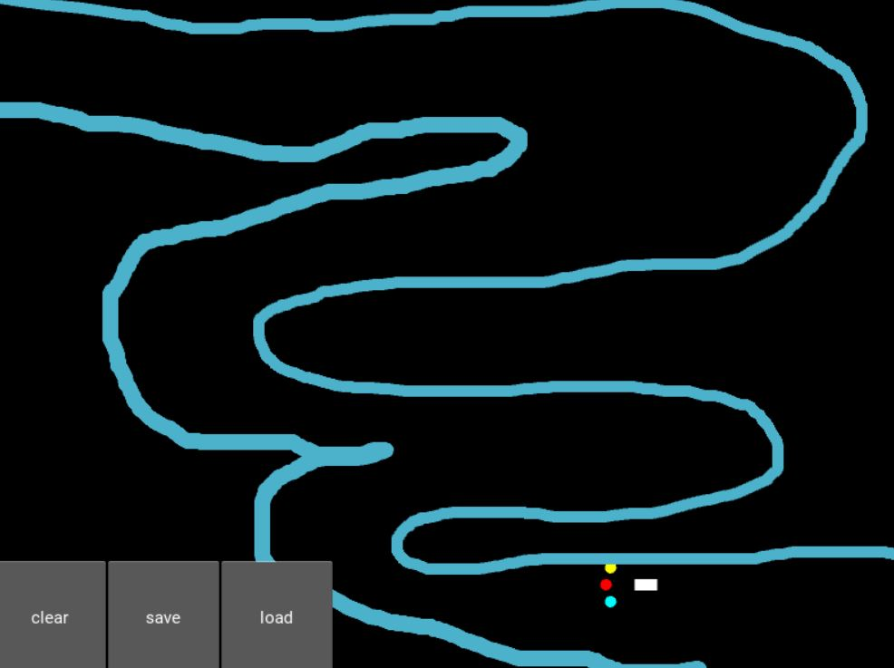
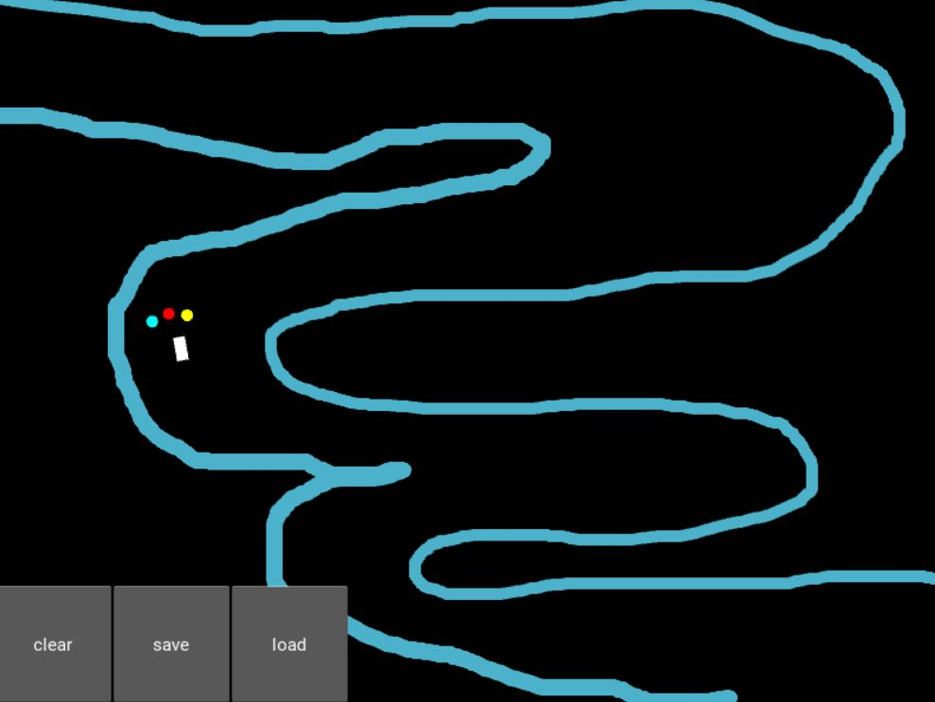
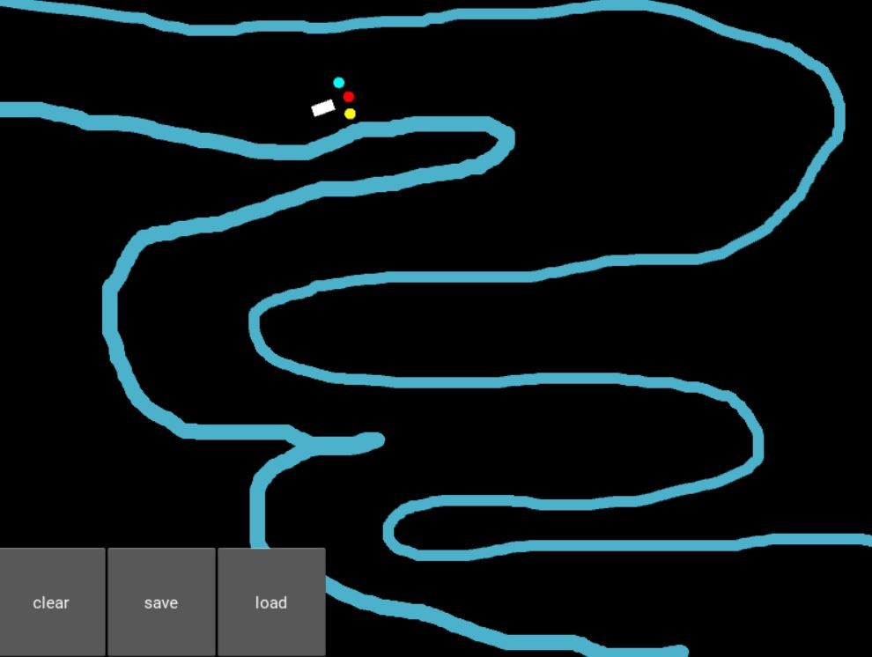
Implementation
Figure 9 shows an object returning from the destination after reaching it, the program changes or alternates the start and destination points after a travel from start to end is completed.
Figures 10 and 11 shows the object learning the environment, and it reaches the starting point back from the destination. This process continues repeatedly as the object learns the environment better and better. Finally the object follows the best path through the obstacle.
Figure 9
Figure 10
Figure 11

Slide 27
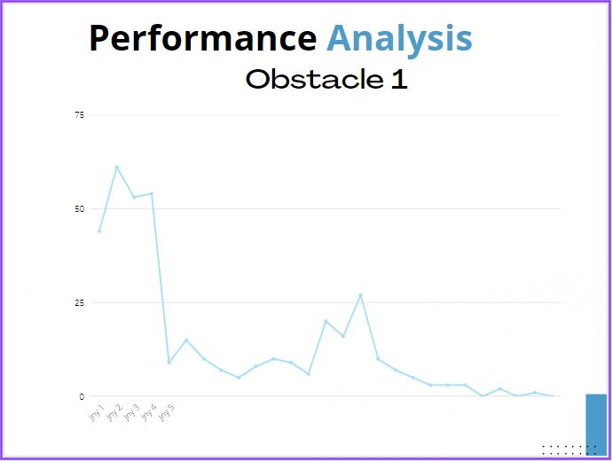
Performance Analysis

Slide 28
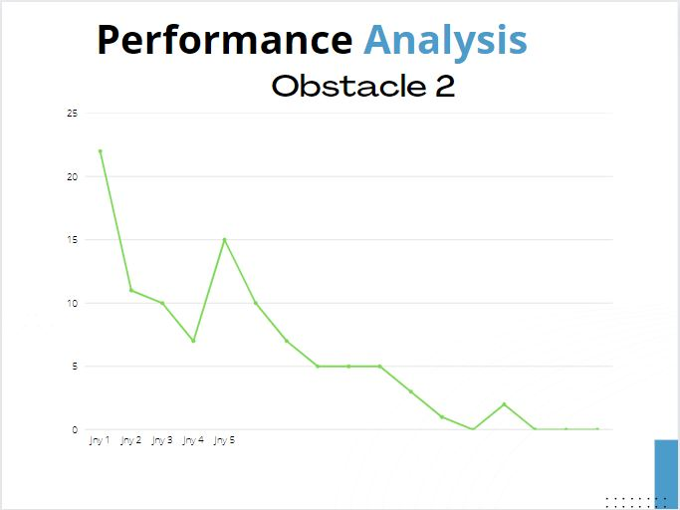
Performance Analysis

Slide 29
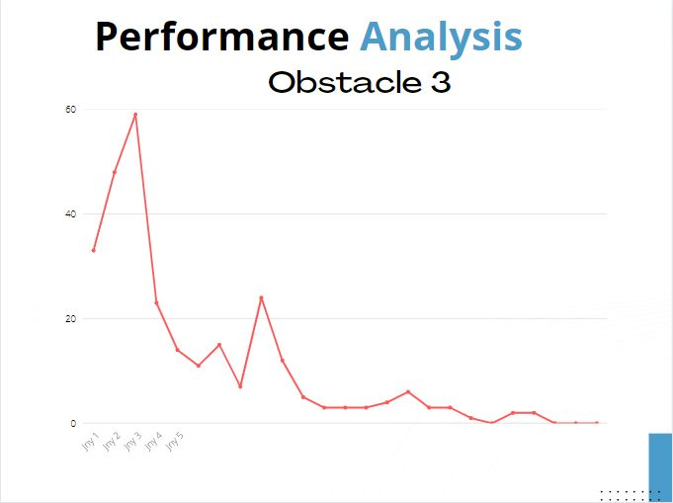
Performance Analysis

Slide 30
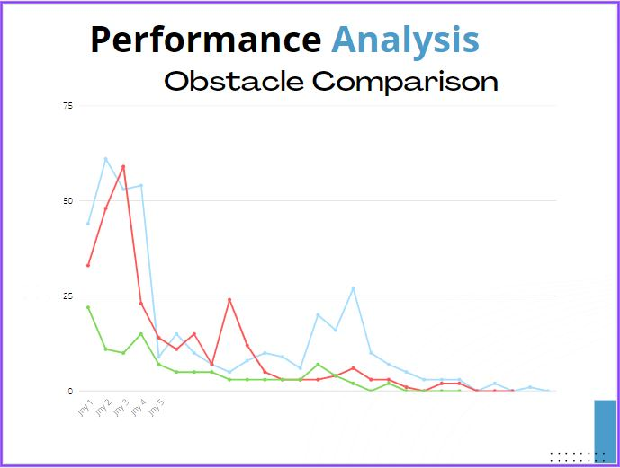
Performance Analysis (Comparison)

Slide 31
Conclusion
Thus we have presented a deep Q-learning based model trained in a virtual environment that is able to make decisions for navigation in an adaptive way.
As inputs it took the information from the three sensors and its current orientation.
As output it decided the Q-values for each of the actions of going straight, turning left or turning right.
As for the rewards, we punished it badly for hitting the sand, punished it slightly for going in the wrong direction and rewarded it slightly for going in the right direction.

Slide 32
References
B. Jang, M. Kim, G. Harerimana and J. W. Kim, "Q-Learning Algorithms: A Comprehensive Classification and Applications," in IEEE Access, vol. 7, pp. 133653-133667, 2019, doi: 10.1109/ACCESS.2019.2941229.
Jiang, L., Huang, H., & Ding, Z. (2019). Path planning for intelligent robots based on deep Q-learning with experience replay and heuristic knowledge. IEEE/CAA Journal of Automatica Sinica, 1–11. doi:10.1109/jas.2019.1911732
L. Lv, S. Zhang, D. Ding and Y. Wang, "Path Planning via an Improved DQN-Based Learning Policy," in IEEE Access, vol. 7, pp. 67319-67330, 2019, doi: 10.1109/ACCESS.2019.2918703.
S. Y. Luis, D. G. Reina and S. L. T. Marín, "A Multiagent Deep Reinforcement Learning Approach for Path Planning in Autonomous Surface Vehicles: The Ypacaraí Lake Patrolling Case," in IEEE Access, vol. 9, pp. 17084-17099, 2021, doi: 10.1109/ACCESS.2021.3053348.
J. Liao, T. Liu, X. Tang, X. Mu, B. Huang and D. Cao, "Decision-Making Strategy on Highway for Autonomous Vehicles Using Deep Reinforcement Learning," in IEEE Access, vol. 8, pp. 177804-177814, 2020, doi: 10.1109/ACCESS.2020.3022755.
S. Jiang, Z. Huang and Y. Ji, "Adaptive UAV-Assisted Geographic Routing With Q-Learning in VANET," in IEEE Communications Letters, vol. 25, no. 4, pp. 1358-1362, April 2021, doi: 10.1109/LCOMM.2020.3048250.
Huang, R, Qin, C, Li, JL, Lan, X. Path planning of mobile robot in unknown dynamic continuous environment using reward-modified deep Q-network. Optim Control Appl Meth. , pp. 1– 18, 2021, https://doi.org/10.1002/oca.2781.

Slide 33
References :
[8] Bae, Hyansu, Gidong Kim, Jonguk Kim, Dianwei Qian, and Sukgyu Lee. "Multi-Robot Path Planning Method Using Reinforcement Learning" Applied Sciences 9, pp no. 15: 3057 ,2019, https://doi.org/10.3390/app9153057.
[9] M. R. Lemos, A. V. R. de Souza, R. S. de Lira, C. A. O. de Freitas, V. J. da Silva and V. F. de Lucena, "Robot Training and Navigation through the Deep Q-Learning Algorithm," 2021 IEEE International Conference on Consumer Electronics (ICCE), pp. 1-6, 2021, doi: 10.1109/ICCE50685.2021.9427675.
[10] Yan, C., Xiang, X. & Wang, C. Towards Real-Time Path Planning through Deep Reinforcement Learning for a UAV in Dynamic Environments. J Intell Robot Syst 98, pp. 297–309 , 2020, https://doi.org/10.1007/s10846-019-01073-3.
[11] W. Zaher, A. W. Youssef, L. A. Shihata, E. Azab and M. Mashaly, "Omnidirectional-Wheel Conveyor Path Planning and Sorting Using Reinforcement Learning Algorithms," in IEEE Access, vol. 10, pp. 27945-27959, 2022, doi: 10.1109/ACCESS.2022.3156924.
[12] Zhang, L., Liu, Z., Zhang, Y., and Ai, J. (2018). Intelligent path planning and following for uavs in forest surveillance and fire fighting missions. In 2018 IEEE CSAA Guidance, Navigation and Control Conference (CGNCC), pages 1–6. IEEE doi:https://doi.org/10.1007/s10586-021-03276-6.
[13] Ranaweera, D. M., Hemapala, K. U., Buddhika, A., and Jayasekara, P. (2018). A shortest path planning algorithm for pso base firefighting robots. In 2018 Fourth International Conference on Advances in Electrical, Electronics, Information, Communication and Bio-Informatics (AEEICB), pages 1–5. IEEE. doi: https://doi.org/10.1109/AEEICB.2018.8480971
[14] Meyes, R., Tercan, H., Roggendorf, S., Thiele, T., B¨uscher, C., Obdenbusch, M., Brecher, C., Jeschke, S., and Meisen, T. (2017). Motion planning for industrial robots using reinforcement learning. Procedia CIRP, 63:107–112 doi: https://doi.org/10.1016/j.promfg.2020.01.023
[15] Jarvis, R. A. and Marzouqi, M. S. (2005). Robot path planning in high risk fire front environments. In TENCON 2005-2005 IEEE Region 10 Conference, pages 1–6. IEEE doi: https://doi.org/10.1109/LEOS.2005.1547854

